Slide 1
Iterators and spans
Michal Žamboch

Slide 2
Iterator
Design pattern for traversing through structures with different implementations
Iterate through arrays, vectors, trees...

Slide 3
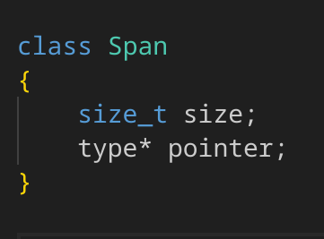
Span
Not owning collection type
Used for safe view of collections
Similar to std::string_view
Basic implementation

